Slide 1
New Faculty Orientation
August 11, 2021
Learning & Student Success
Betsi Burns
Assistant Dean/Director, Learning and Student Success
bburns4@luc.edu

Slide 2
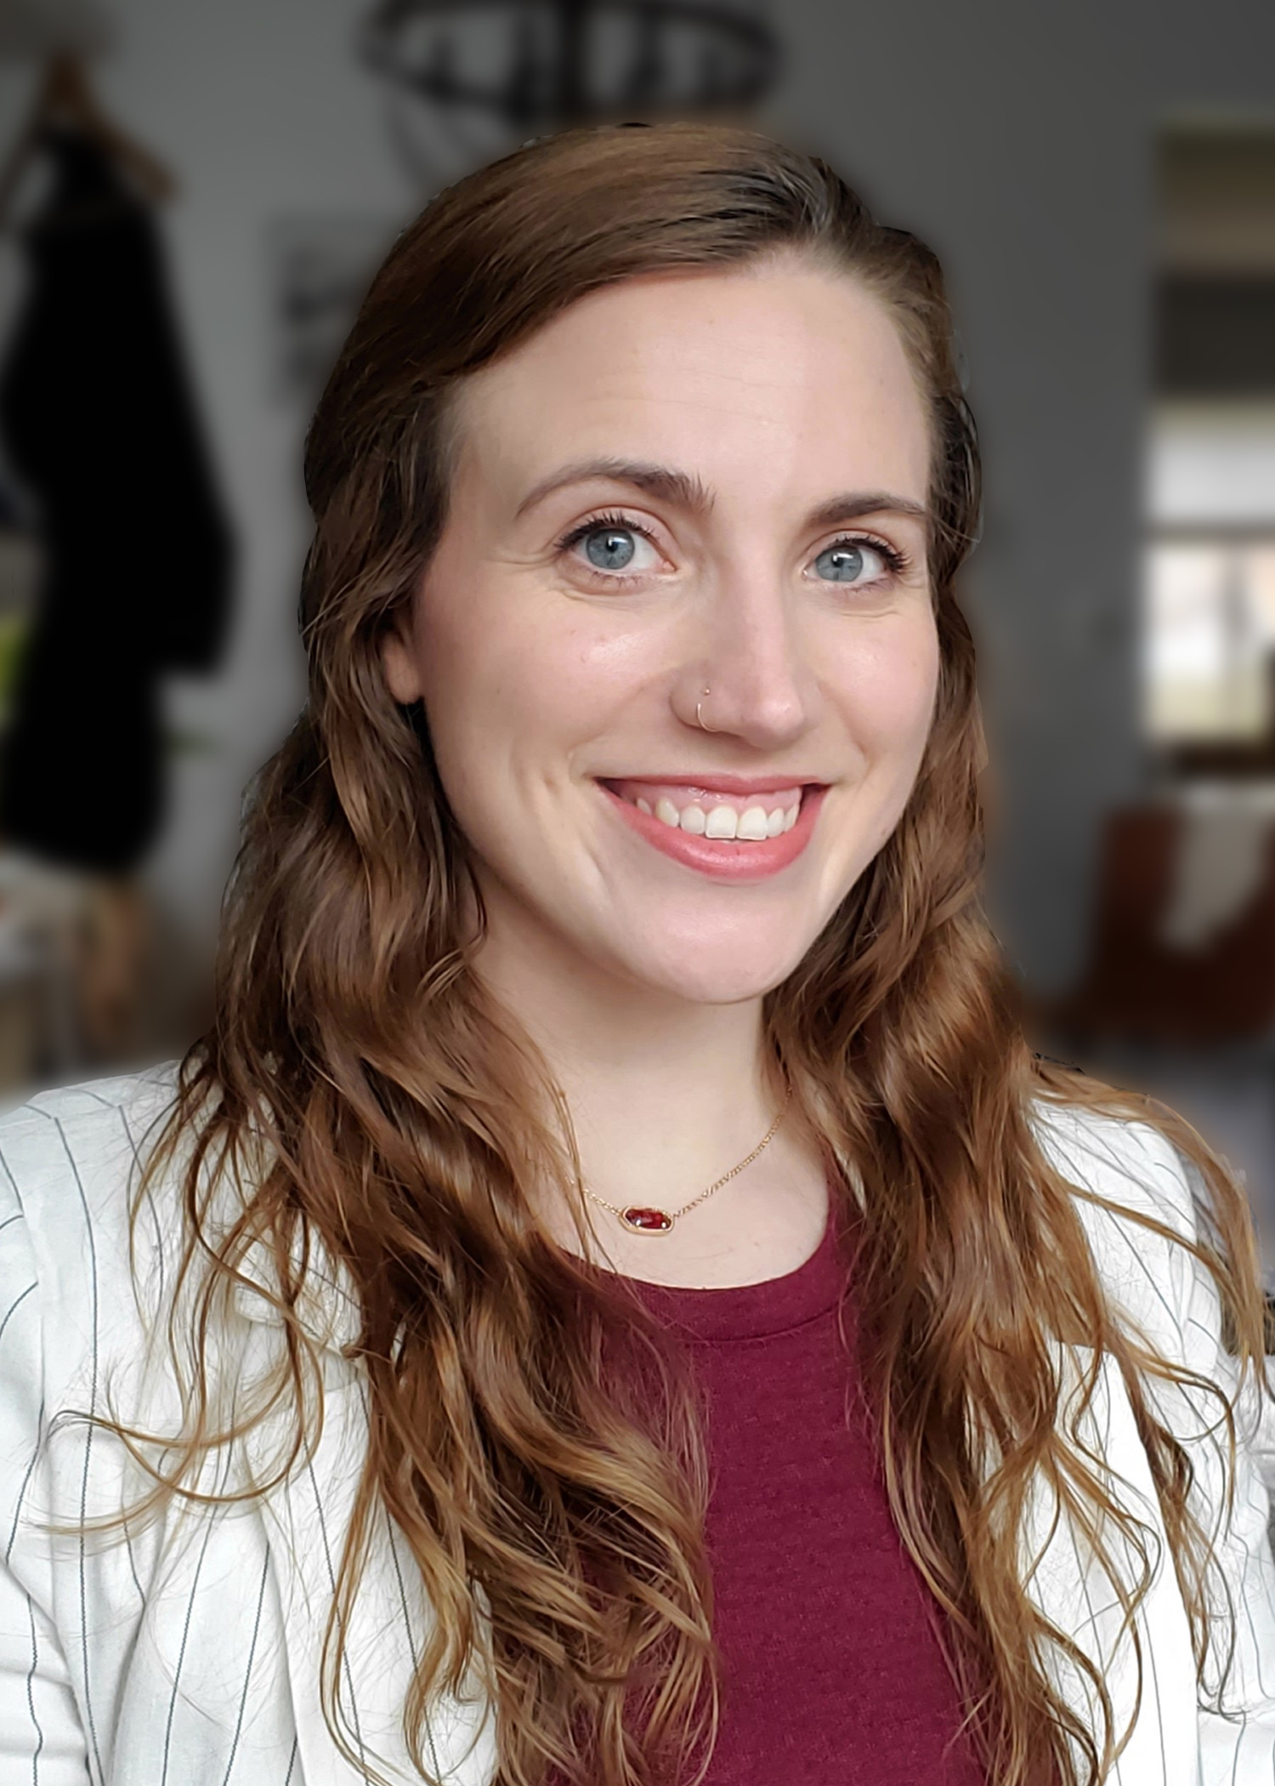
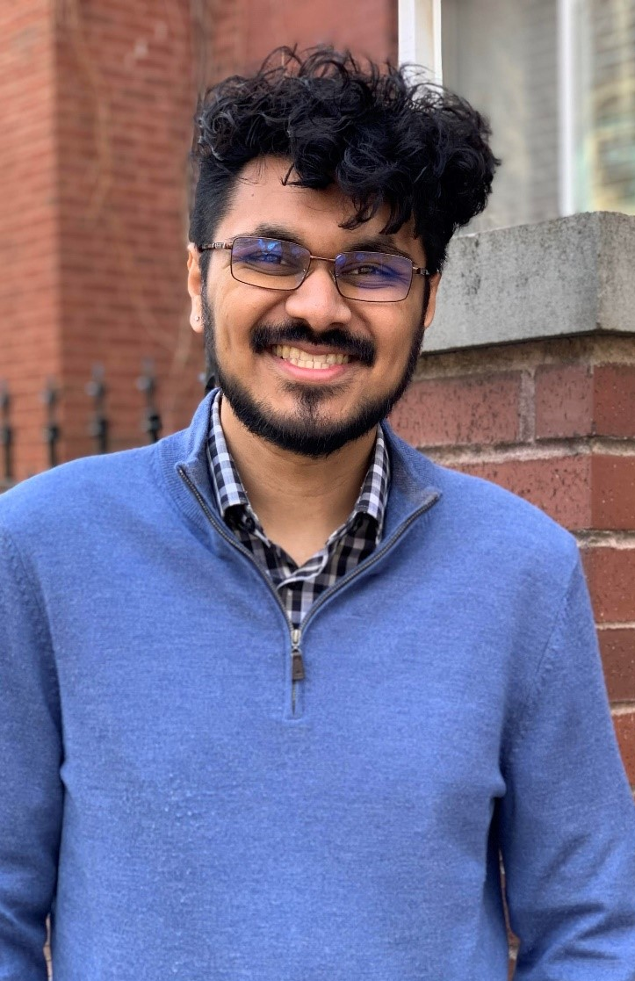
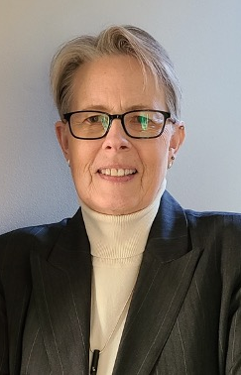
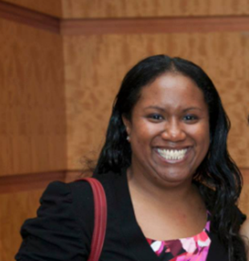
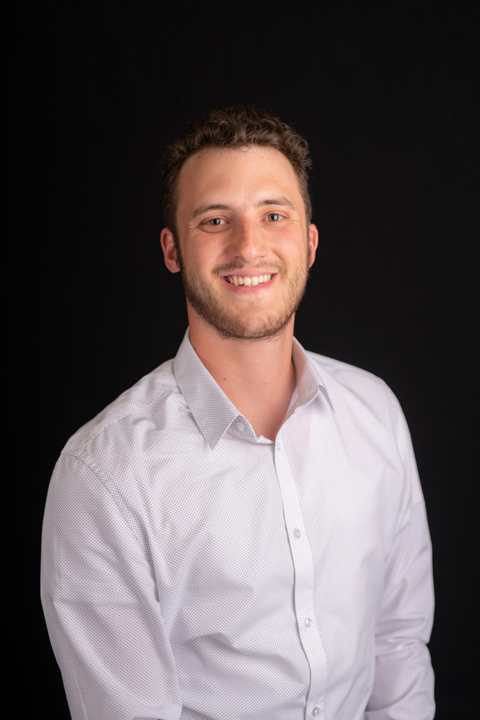
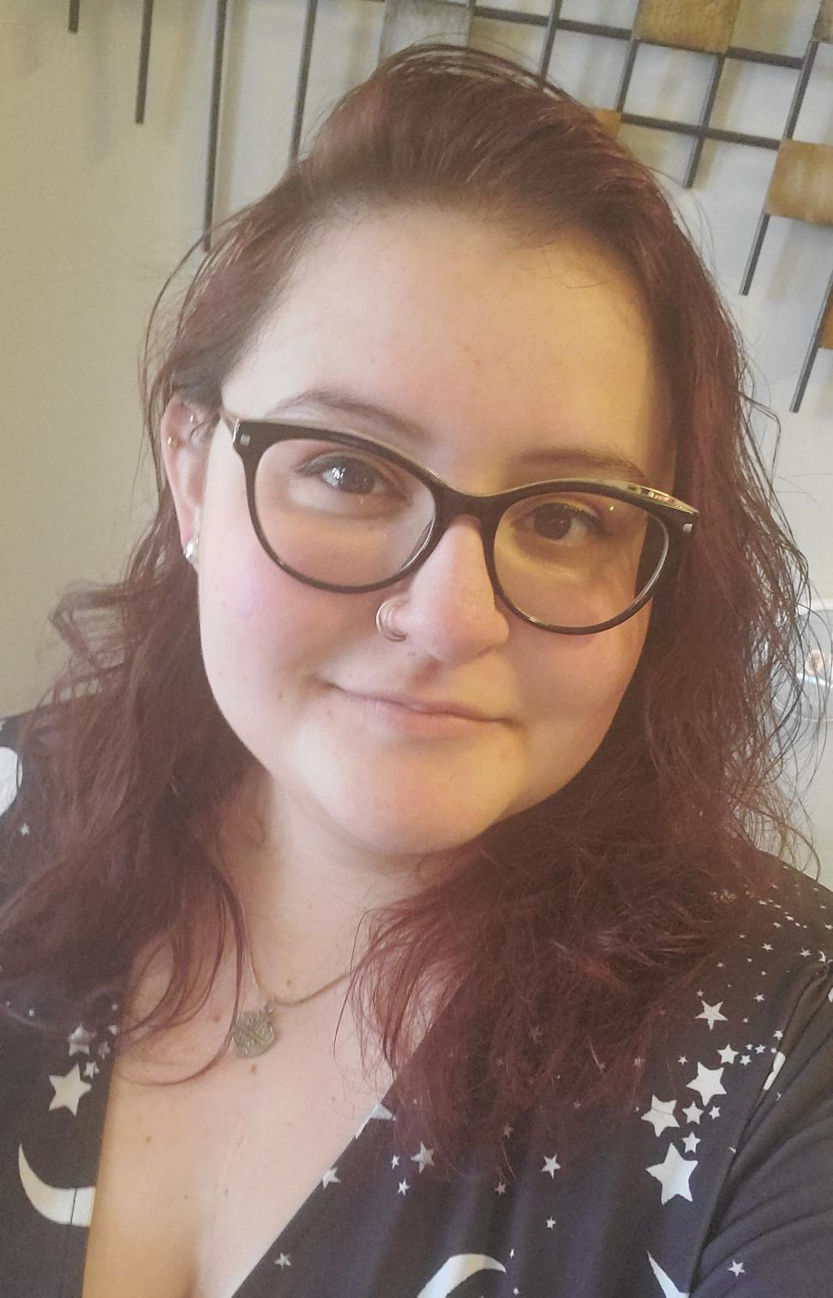
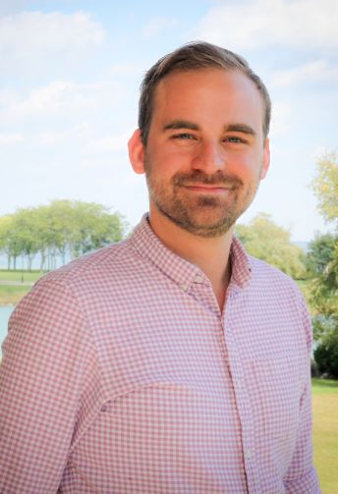
Betsi Burns
Director,
L&SS
Eric Perry
Admin Assistant, L&SS
Mary Kate Daniels
Assistant Director, L&SS
Jessie LaChance
Associate Director,
Tutoring Center
Mustafa Anwar
Coordinator,
Tutoring Center
Sherene Awong
Accessibility Specialist,
SAC
Debra Miller
Associate Director, SAC
Ben Suits Baer
Assistant Director,
SAC
Hollie Ferrer
Accessibility Specialist,
SAC
Matt Williams
Accessibility Specialist,
SAC
Notes:
Staff Pictures

Slide 3
Learning and Student Success https://www.luc.edu/sas/learningandstudentsuccess/
Student Success
Student Accessibility Center
Tutoring Center
We foster student success utilizing a collaborative, student-centered approach to provide an accessible learning environment through academic support and programming. We believe in empowering students to be self-advocates on their path to achieving holistic wellness and academic independence.
Highlighted Initiatives:
Placement Tests
Academic Alerts
Academic Concerns Referrals
Majors and Minors Fairs
Rambler Resources for Student Success
The Kettle Newsletter
Outreach initiatives
Notes:
Three gears working together as one unit to support the learning and success of our students to, through and beyond Loyola.
Student Success Initiatives including academic alerts and outreach in order to support the success of all students at Loyola.
Tutoring Center
Student Accessibility Center
Turn it over to Annie and the Tutoring Center!

Slide 4
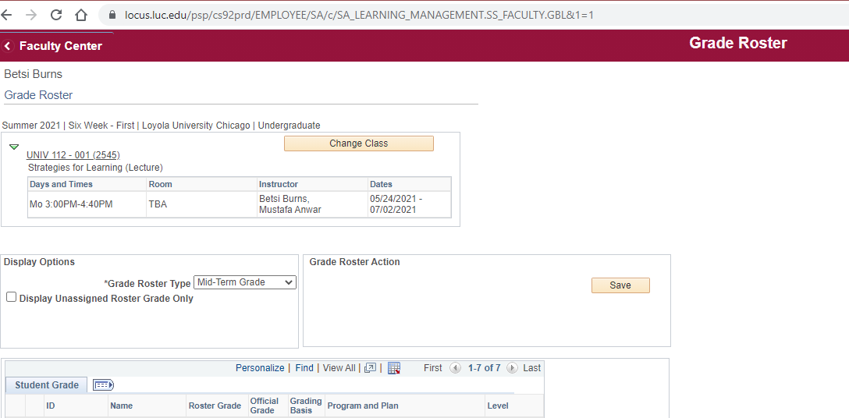
Midterm Grade Rosters
Open first week of classes
Important to enter NRs as soon as possible
Please enter all grades – good and bad
Alerts sent to those with C- or below

Slide 5
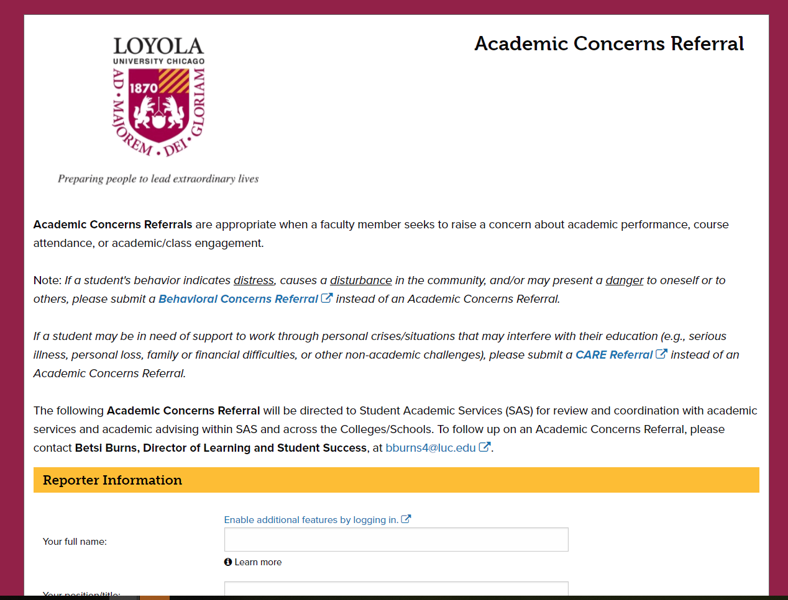
Academic Concerns Referrals
https://cm.maxient.com/reportingform.php?LoyolaUnivChicago&layout_id=3

Slide 6
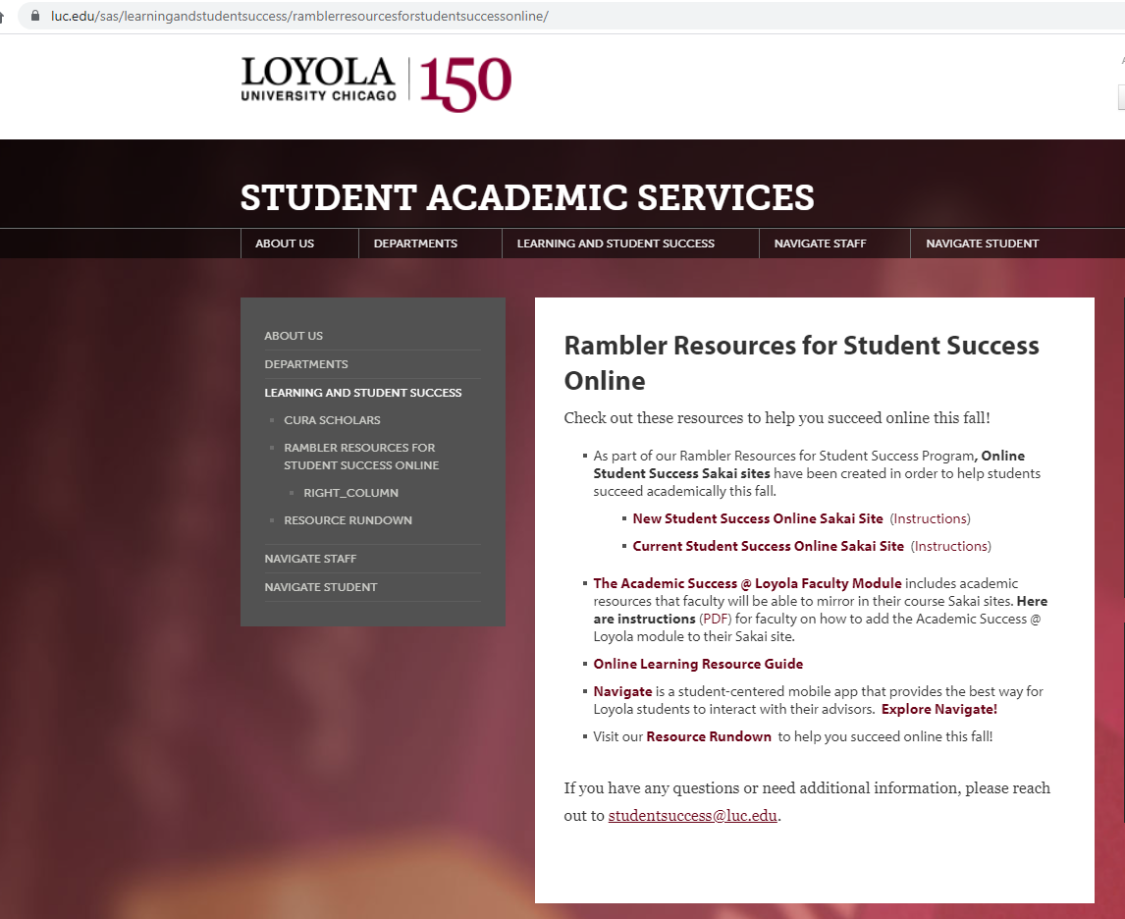
Rambler Resources for Student Success
www.luc.edu/ramblerresources
Notes:
What is Navigate?
Navigate is a student-centered mobile app that provides the best way for Loyola students to interact with their advisors -- as well as personalized information to keep you on the path toward academic success!
Research shows that students learn more and remember information longer when they actively engage in their own learning. One of the best ways to do this is to work in groups. When you and your peers begin asking each other questions, thinking through solutions together, and hearing answers to questions you hadn’t even thought of, you learn more. Students who study in groups learn 2.5 times more than those who study alone. The Navigate Study Buddies app helps connect you with others in your classes who are interested in forming study groups.
The Tutoring Center offers FREE small group peer tutoring, in addition to Supplemental Instruction and Success Coaching. For more information about the peer tutoring program and how to schedule an appointment for your study group, visit https://luc.edu/tutoring/ourservices/tutoring.

Slide 7
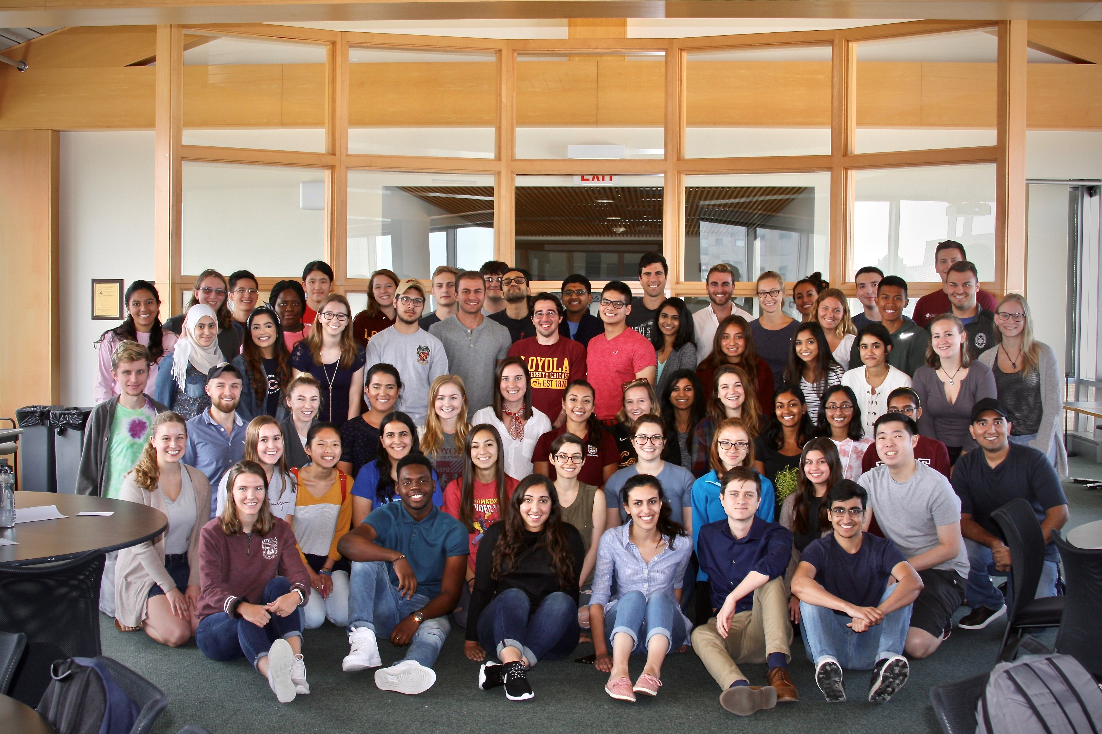
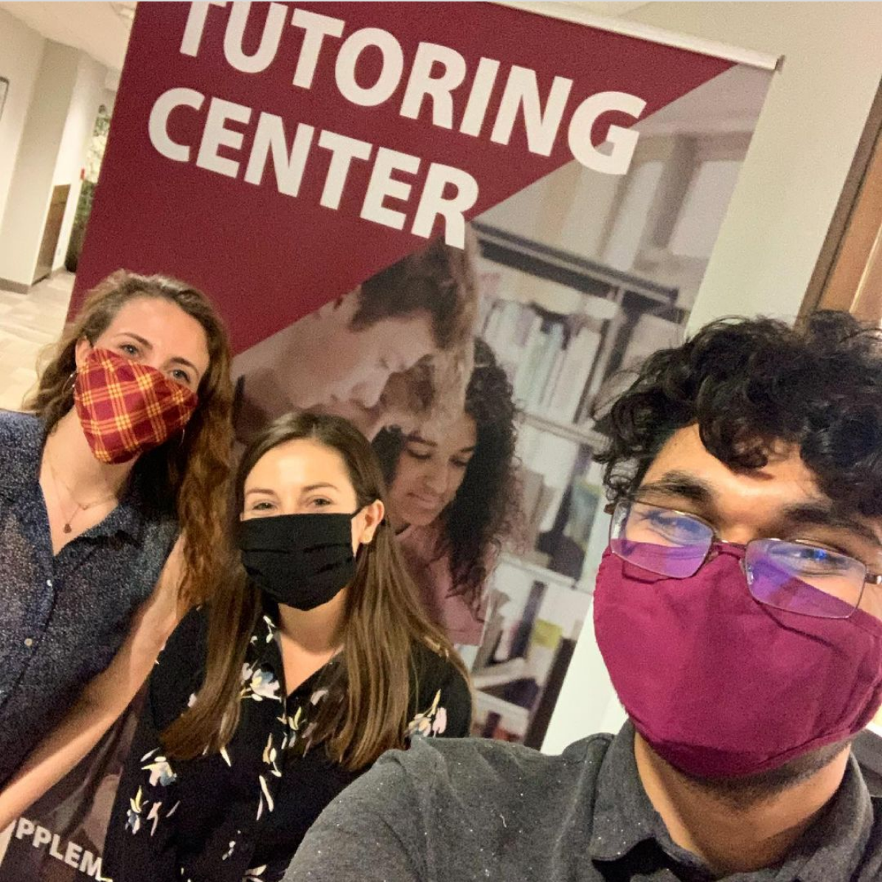
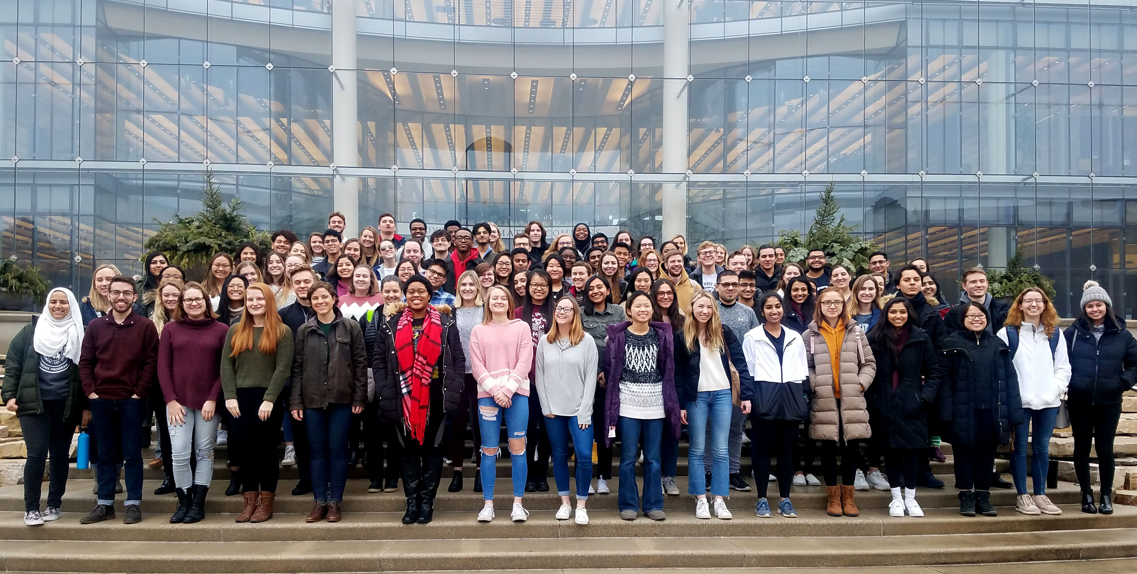

Slide 8
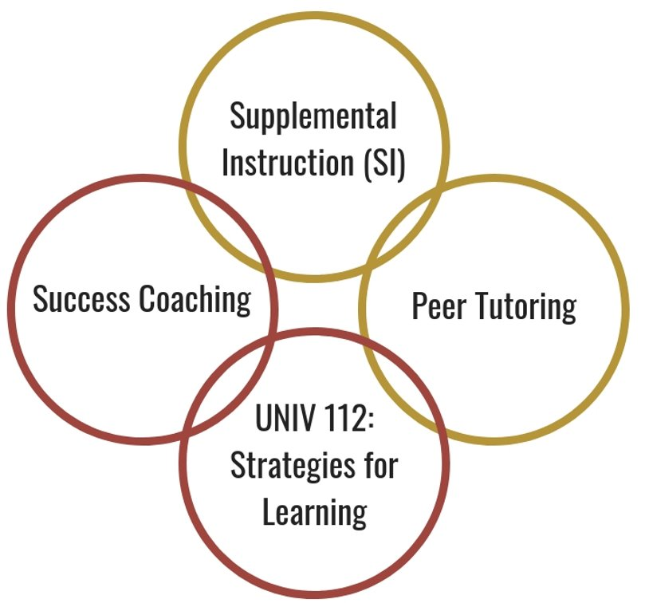
Tutoring Center
Our Goal: Help students succeed academically!
Locations: Sullivan Center (LSC), Lewis Towers (WTC), and online
FREE services for all undergrad LUC students!

Slide 9
Peer Tutoring and Supplemental Instruction (SI)
Success Coaching
Review Course Concepts
Make new friends
Led by an upper-class student
Supports select 100 and 200 level courses
Drop-in sessions (SI & tutoring)
Appointments (tutoring)
One-on one coaching with a trained graduate student
Individualized to meet your specific academic needs
Hone in on executive functioning skills (time management, exam prep, concentration, etc.)

Slide 10
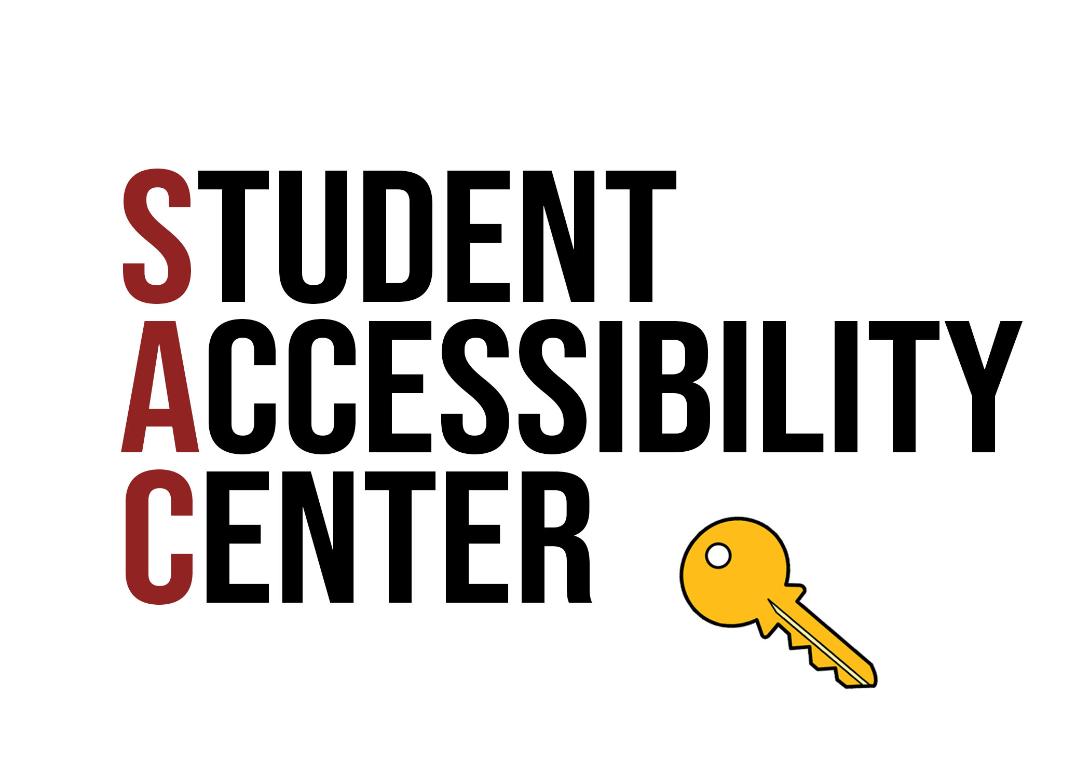

Slide 11
Registration process
Accommodations
1
Student completes online
registration form and
uploads documentation
An interactive process and are determined on a case by case basis
Provide opportunities for equal access but do not guarantee success
Are not retroactive! We encourage all students who may need accommodations to register prior to Fall 2021.
2
SAC reviews and contacts student to
schedule meeting
3
Student meets with SAC staff to discuss accommodations

Slide 12
Student Accessibility Center
SAC's mission is to support, service, and empower students with disabilities.
SAC leads the campus community in its commitments to
recognize disability as a valued aspect of diversity
embrace access as a matter of social justice
design more welcoming and inclusive environments
SAC collaborates with students, faculty, and campus partners to implement reasonable accommodations.

Slide 13
What are Accommodations?
Provide opportunities for equitable access to course content, but do not guarantee success
Remove barriers to create a level playing field
Modifications to a student's academic environment that remove barriers
Determined on a case-by-case basis through an interactive process
Not meant to change the "fundamental nature" of the course or assignment

Slide 14
Accommodations at LUC
Academic
Testing-extra time; private room; scribe; specific software
Priority registration
Housing
Specialized equipment; emotional support animal
Dining
Dietary restrictions; allergies
Transportation
Shuttle between campuses

Slide 15
Assistive Tech and Auxiliary Services
CART (Communication Access Realtime Translation)
Live captioning (Teams and Zoom)
Captioning or ASL interpreter?
Alt Text
Plain text for screen readers
Descriptive text for images
PDF format
Notes:
Assistive Tech:
CART – live-captioning (Teams and Zoom both have auto-caption software) (Communication Access Realtime Translation
) captioning can apply to numerous disabilities/people in attendance, whereas ASL applies specifically to those who can use it
Plain text for screen readers
Descriptive text for images
Pdf format
ASL Interpreters

Slide 16
SAC Students
A person who has a physical or mental impairment that substantially limits one or more major life activity.
~2,150 students registered with SAC
Notes:
I think it's important to note that ~96% of these students may not have a 'visible' or 'recognizable' disability – we won't always know that someone in attendance would benefit from accessibility measures and inclusive, universal design
Students self-identify these disabilities on registration, students have co-morbid diagnoses, some diagnoses are temporary

Slide 18
SAC Contact Information for Faculty
Contact us: SAC@luc.edu
Accommodate:
https://luc-accommodate.simplicity.com
Notes:
All

